Slide 1

Evaluation and Human Subjects Research
Julie M. Aultman, Ph.D.
Chair, Institutional Review Board
Associate Professor, Family and Community Medicine
Northeast Ohio Medical University

Slide 2
Important Questions
What is research?
What is human subjects research?
What is program evaluation?
Who is engaged in human subjects research?
What do I do if I want to engage in human subjects research?

Slide 3
What is research?
Research is a systematic investigation, including research development, testing and evaluation, designed to develop or contribute to generalizable knowledge.
Generalizable knowledge is when the activity’s conclusions are intended to be extended beyond the sample or internal program.

Slide 4
Generalizable Knowledge includes one or more of the following:
The data is geared for scholars, practitioners, and/or researchers within a specified field of study
Note: Activities may involve comparing and contrasting multiple interventions/interactions, such as survey tools, educational screening tools or testing procedures
Results of the study are presented either by presentation and/or publication in order to illuminate some topic/issue within one’s field of study
Results from the study are applied to some population in addition to the sample
The study’s results can be replicated by others
The study provides input into some field of study
*adapted from the University of Wisconsin and the University of Michigan

Slide 5
What is human subjects research?
A human subject means a living individual about whom an investigator (whether professional or student) obtains:
Data through intervention or interaction with the individual, or
Identifiable private information
The research contributes to generalizable knowledge

Slide 6
What is Program Evaluation?
The purpose of PROGRAM EVALUATION is to:
inform decisions
identify improvements [i.e. formative evaluation]
provide information about the success of programs [i.e. summative evaluation] according to predefined goals and objectives.
Program Evaluation focuses on making judgments ABOUT THE PROGRAM, to improve or further develop program effectiveness, and inform decisions about future programming, and/or increase understanding.

Slide 7
Program Evaluation DOES NOT involve human persons directly.
They are about practices and programs and not about human subjects.
You may present or publish program evaluation projects, but it must not be labeled as human subjects research. It should be labeled as “program evaluation.”
If you produce generalizable data or involve persons directly, you are conducting human subjects research and must go through the IRB.

Slide 8
EXAMPLES

Slide 9
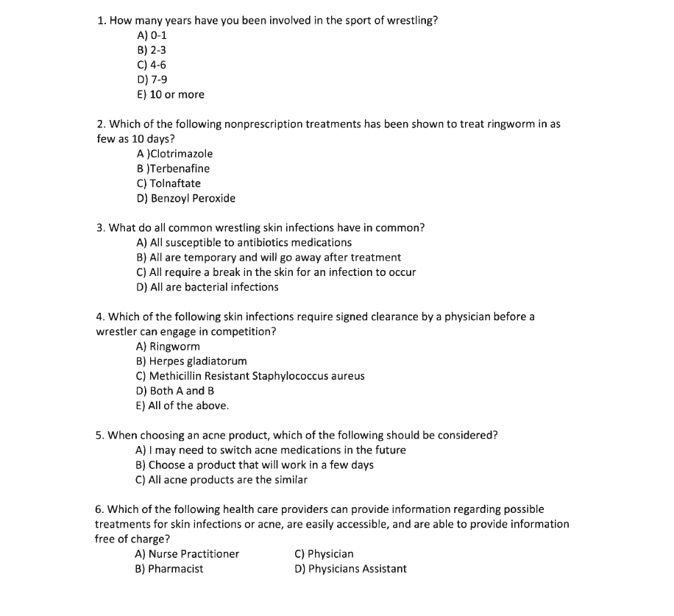

Slide 10
EVALUATION OR HSR?
How effective was the presentation on teen stress?
How often do you feel overwhelmed during school?
What did you learn from the presentation on how to manage stress?
How effective was the presenter in describing the different levels of stress and how to manage it?
How have you managed your own stress before, during, or after school?
Do you think your stress has become so out of control that you want to harm yourself?
What recommendations do you have to improve the presentation?

Slide 11
Who is engaged in human subjects research?
If you are conducting a study ABOUT persons and not about the program or activity, you are engaged in human subjects research.
Engagement includes:
Development of human subjects research methods
Implementing human subjects research methods
Recruiting participants
Going through the informed consent process
Collecting data
Analyzing data
Disseminating data

Slide 12
The Institutional Review Board
If you are engaged in human subjects research, you must submit an IRB application, also known as a protocol.
The application is a detailed proposal of your research intentions, which is reviewed by the IRB Chair and the Human Protections Administrator (for exempt and expedited research), or by the FULL Board for more than minimal risk studies (or those proposals that involve vulnerable populations*).
Human subjects research may not begin until you have approval from the IRB.
* Vulnerable populations include, but are not limited to, children, pregnant women/fetuses, prisoners, and the mentally ill.

Slide 13
Why is a review process of HSR important?
It is important to respect all persons and their values such as privacy and dignity. When persons are being studied, it is important they are aware of the risks and benefits of the research and that their voluntary choices about participating in the research are respected.
The IRB protects human subjects by overseeing any research that requires their participation. Through the review process, the IRB prompts investigators to conduct research justly and to ensure the safety and protection of subjects.

Slide 14
NON-COMPLIANCE
If you do not go through the IRB when conducting human subjects research you are not in compliance with institutional, state, and federal regulations (45 CFR 46).
NON-COMPLIANCE MAY LEAD TO SERIOUS RAMIFICATIONS FOR YOU AND NEOMED, PARTICULARLY IF VULNERABLE POPULATIONS ARE INVOLVED.
We are happy to answer questions and help you determine whether your project is human subjects research or not.
If you are unsure whether your project involves program evaluation, quality improvement, or human subjects research, contact the IRB (Trish Wilson, x6364 or paw@neomed.edu; or Julie Aultman x6113 or jmaultma@neomed.edu).

Slide 15
Questions?

